Slide 1
KIỂM TRA BÀI CŨ

Slide 2
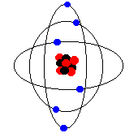
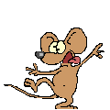
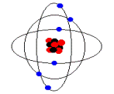
A quiz
Question 1
You can watch a film at the………….
Key
swimming pool c. park
d. hospital
b. cinema/ movie theater

Slide 3
A quiz
Question 2
You can borrow a book at the………….
Key
c. library
a. bookshop
b. garage d. cafe

Slide 4
A quiz
Question 3
I’m going to the………to have some coffee and
cake with my friends.
Key
a. cafe
c. supermarket
b. school d. circus

Slide 5
A quiz
Question 4
She sometimes swims in the………..
Key
a. playground c. supermarket
b. museum
d. swimming pool

Slide 6
A quiz
Question 5
You can see many objects of scientific,
or dinosaurs bones at the………………….
Key
a. park c. supermarket
d. pool
b. museum

Slide 7
A quiz
Question 6
I’m always play soccer with my
friends at the……………………
Key
c. playground
a. pool
b. bookshop d. museum

Slide 8
A quiz
Question 7
He never buys clothes at the ………….
Key
c. shopping mall
a. library
b. cafe d. museum

Slide 9
Friday, Feb 22 ^{nd} 2021
Unit 7: Places to go!

Slide 10
P 55

Slide 11
P 55

Slide 12
1 minute
shield
quilt
child
child
adult
field
quilt
adult
adult
shield

Slide 13
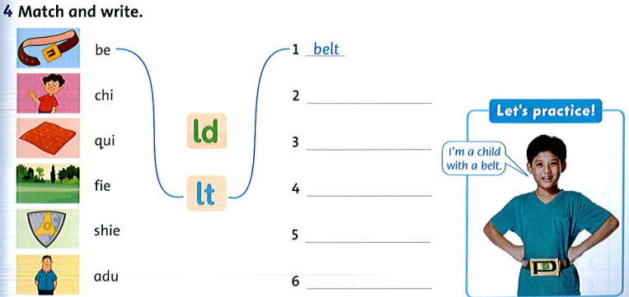
2 minutes
child
quilt
shield
field
adult
P 55

Slide 14
P 56

Slide 15
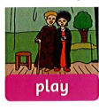
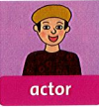
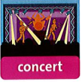

Slide 16
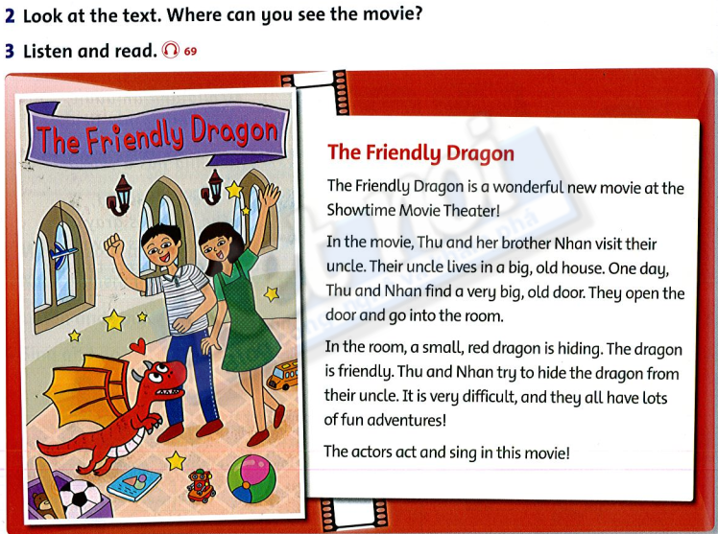
P 56

Slide 17
No
No
Yes
Yes
2 minutes
Yes
P 56

Slide 19
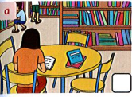
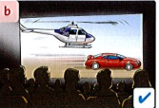
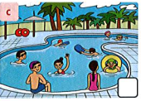
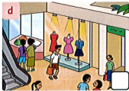
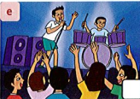
P 57

Slide 20
P 57

Slide 21
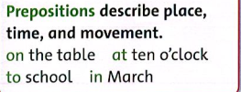
P 57

Slide 22
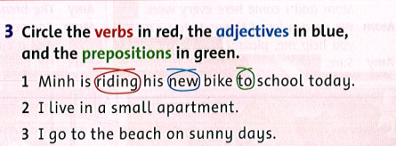
1 minute

Slide 23
HOMEWORK WORKBOOK PAGES ON 50, 51,52

Slide 24
Tuesday, February 23rd 2021
Unit 7
Lesson 4, 5,6
Viết phần này vào tập nha!
child
shield
field
belt
quit
adult
play
concert
actor
movie
singer

Slide 25
Viết phần này vào tập nha!
Do you like watching movies?
Yes, I do. / No, I don’t.
Do you ever go to the movie theater?
I sometimes go to the movie theater.

Slide 26
GOOD BYE!

